Slide 1
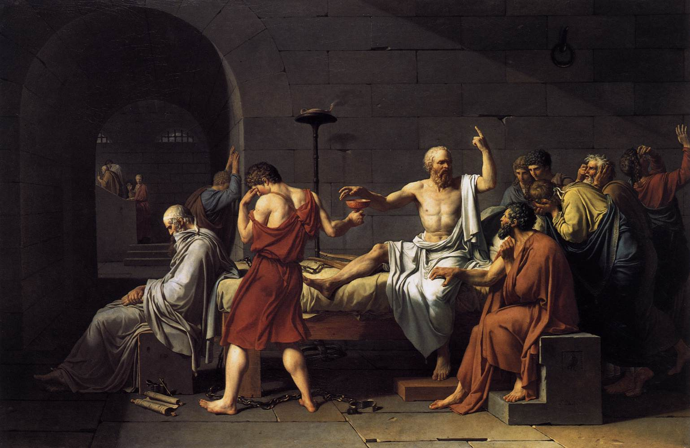

Phil 31 / E-101: Saints, Heretics and Atheists – An Historical Introduction to the Philosophy of Religion

Slide 2
Saints, Heretics, and Atheists
Welcome to Phil 31/E-101: Saints, Heretics and Atheists!

Slide 3
Saints, Heretics, and Atheists
What is this course about?
We might say: Big Themes, Great Works, Historical Context

Slide 4
Saints, Heretics, and Atheists
Big themes:
Some obvious: Does God exist? What’s the nature of God? What about evil? Can we be good without God or religion?
Some less obvious: Would immortality be a good thing? What is deism? Is religion useful?
Supplemented by optional, contemporary readings.

Slide 5
Saints, Heretics, and Atheists
Great works:
We will be reading some of the greatest, most enduring works in the history of Western thought, works, for example, by Plato, Aquinas, Marguerite Porette, Al-Ghazali, Pascal, Hume, Spinoza, Nietzsche, and William James.
Our readings are typically short but difficult; they repay careful study.
Not all of these works will stick with you, but I promise some will, different ones for different people.

Slide 6
Saints, Heretics, and Atheists
Historical context:
We’ll read our main works in chronological order.
They range from the Fifth Century BCE to the Twentieth Century.
Why an historical approach?
  More interesting
  To understand the present, you need to understand the past.

Slide 7
Saints, Heretics, and Atheists
Full course details available online
A few course details at end of lecture
I want to jump right in and give you a sense of what a regular class will be like.

Slide 8
Lecture 1: What is Piety?

Slide 9
Introduction

Slide 10
Introduction
Today’s music is from the 5th century BCE, the Golden Age of Greece
  A sham: first musical notation is from two centuries later
  I’ll try to have clips playing at the beginning of class from each period

Slide 11
Introduction
Today’s image is of Jacque Louis David’s The Death of Socrates (1781).

Slide 12
Introduction
Any thoughts?
Depicts the death of Socrates as described by our first author Plato.
Not a bad look for philosophers: holding forth, people lamenting, buff!
Along with music, we’ll start each class with a relevant image.

Slide 13
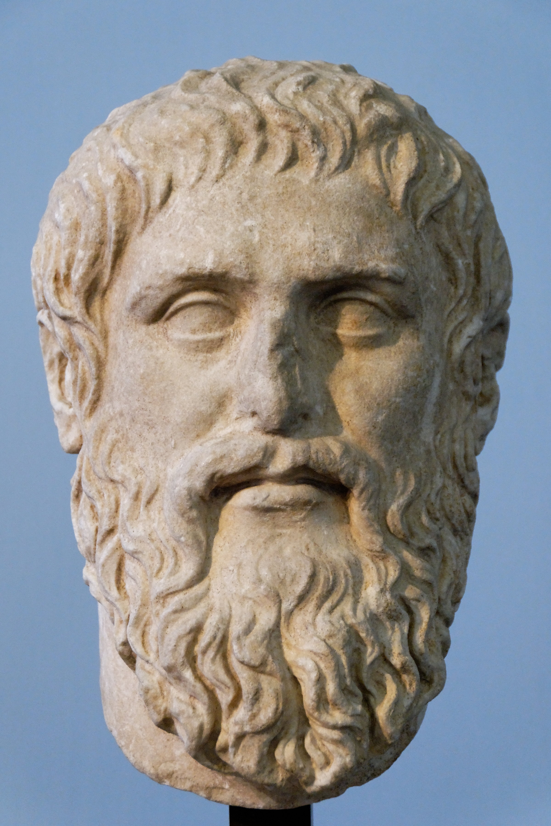
Introduction
Our first work is Plato’s Euthyphro.
Plato was born in Athens, Greece.
He lived ca. 427-347 BCE.

Slide 14
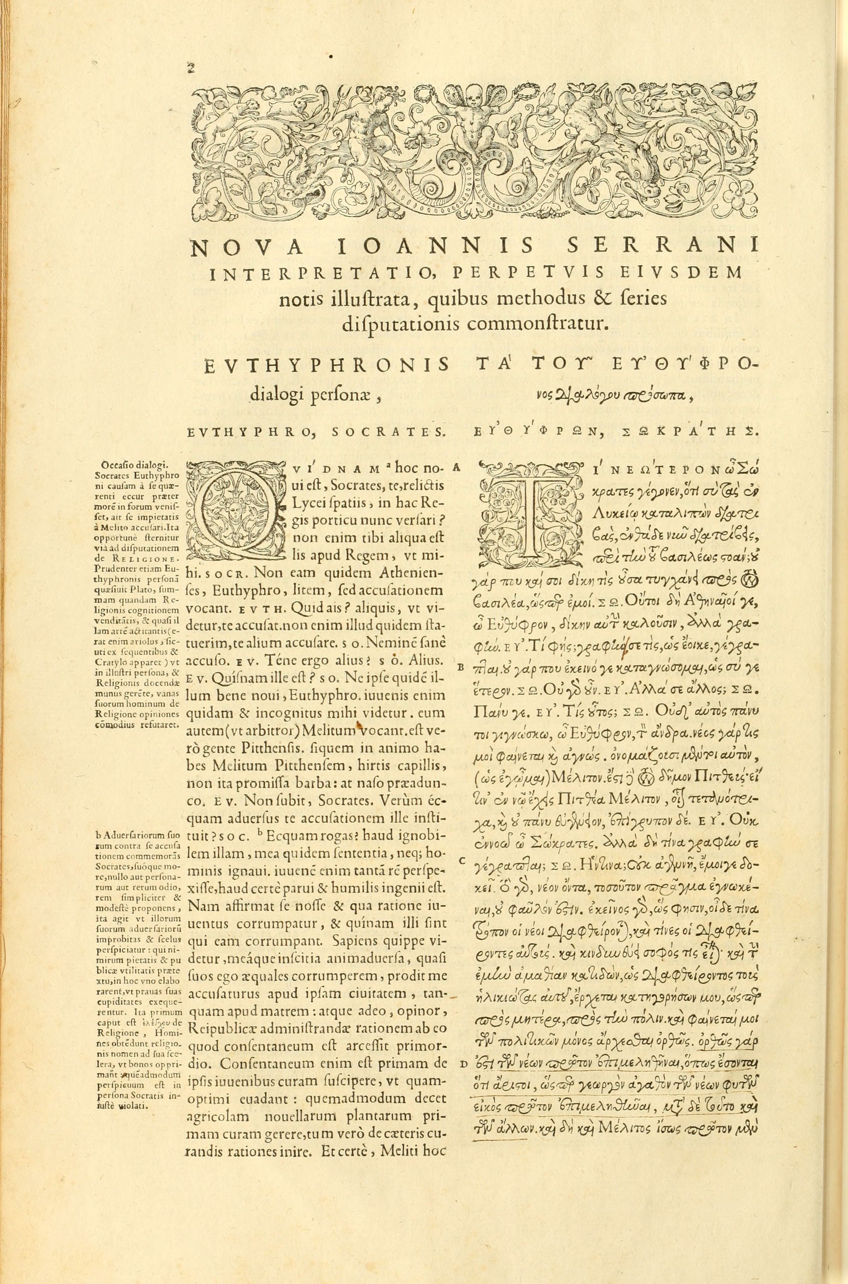
Introduction
The Euthyphro has two main characters: Socrates and Euthyphro.

Slide 15
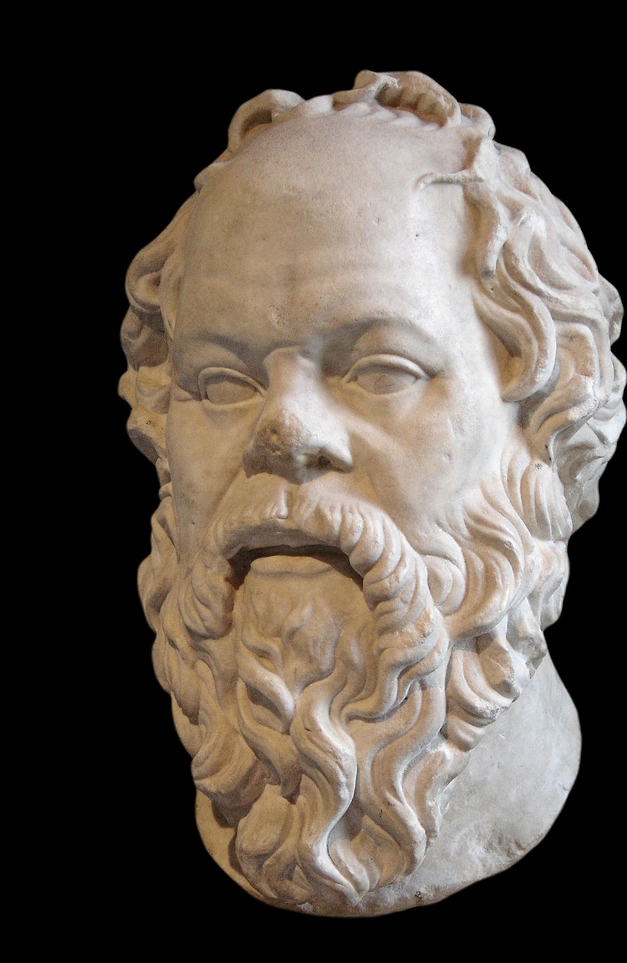
Introduction
Socrates, ca. 470-399 BCE.
Plato’s teacher
Father of western philosophy
Brought to trial on charges of introducing strange gods and corrupting the youth
Executed by Athens

Slide 16
Introduction
Euthyphro is a professional priest and “talking head” on matters of ritual and piety.
On his way to prosecute his father for murder.

Slide 17
Introduction
Euthyphro: The victim was a dependent of mine, and when we were farming in Naxos he was a servant of ours. He killed one of our household slaves in drunken anger, so my father bound him hand and foot and threw him in a ditch, then sent a man here to inquire from the priest what should be done. During that time he gave no thought or care to the bound man, as being a killer, and it was no matter if he died, which he did. Hunger and cold and his bonds caused his death before the messenger came back from the seer. (4c-d)

Slide 18
Introduction
By standards of the time, it is not clear that the father did anything wrong.
Socrates (and Plato) think that prosecuting your own father for murder is morally complex.
It is not clear that it is appropriate for a son to prosecute his father.

Slide 19
Introduction
Socrates suggests that if Euthyphro is so certain, he must have a deep and exact knowledge of piety.
Socrates therefore asks him to explain what piety and impiety are.
In the dialogue, a number of different accounts of piety are offered by Euthyphro and examined by Socrates.

Slide 20
Examples of Piety

Slide 21
Examples of Piety
Euthyphro begins by suggesting that pious and impious things should simply be identified with the sorts of things that he and the gods do and refrain from doing.
Socrates is characteristically unsatisfied; he was hoping for an account, definition, or logos of piety, not just examples.

Slide 22
Examples of Piety
Socrates: Remember that I did not ask you to give me two or three examples of piety, but to explain the general idea which makes all pious things to be pious. Do you not remember that there was one idea that made the impious impious, and the pious pious
Euthyphro: I do.
Socrates: Tell me what is the nature of that idea … a standard … by which I may measure actions … and then I shall be able to say that such and such an action is pious, such another impious. (6d)

Slide 23
Examples of Piety
Any thoughts?
A small point:
One could challenge Socrates’s demand (consider, for example, games).
Nonetheless, Euthyphro’s extreme confidence might suggest that he thinks there are clear and unambiguous criteria separating the pious from the impious.

Slide 24
What Is Dear to the Gods

Slide 25
What Is Dear to the Gods
Euthyphro: Well then, what is dear to the gods is pious, what is not is impious. (7a)
Any thoughts?
Earlier, Socrates confirmed that Euthyphro believes in the Greek gods and all they do.
But this presents a difficulty: what if the gods disagree?

Slide 26
What Is Dear to the Gods
Note, there is a contemporary corollary: what is pious can’t just be what religion says, because there are lots of religions and they don’t always agree.
We’ll return later to the question of religious diversity, but let’s note here three big views among believers.

Slide 27
What Is Dear to the Gods
Exclusivists maintain that there is one correct religion, and that those who believe and act in accordance with that religion will alone enjoy its benefits and rewards.

Slide 28
What Is Dear to the Gods
Inclusivists maintain that there is one true religion, and generally one set of revealed or sacred texts, but nonetheless maintain that even those who do not share belief in the true religion may enjoy its benefits and rewards, often in large by pursuing a strictly false religion in a way that resonates with the moral dictates of the true religion (e.g. “the virtuous pagan”).

Slide 29
What Is Dear to the Gods
Pluralists maintain that many different religions may be striving after the same truth, and that none has a complete and full grasp of the truth.
This non-relativist view is often illustrated with an elephant metaphor: different religions are touching different parts of one larger truth.

Slide 30
What All Gods Love

Slide 31
What All Gods Love
After some prompting, Euthyphro settles on a third definition: "the pious is what all the gods love, and the opposite, what all the gods hate, is the impious" (9e).
How is that different?

Slide 32
What All Gods Love
Euthyphro’s third attempt directly responds to the previous objection: piety concerns only those things that all religions agree upon.
An intuitive move: you might think that what religions disagree about is less important than what the agree about.
This is the view behind the idea of “core religious values”.

Slide 33
What All Gods Love
It is at this point that Socrates raises the most famous objection of the entire dialogue:
  “Is the pious being loved by the gods because it is pious, or is it pious because it is being loved by the gods?” (10a).
This question is really an objection: what is the thought?

Slide 34
What All Gods Love
Granting that the gods love the pious, Socrates thinks the order of explanation is important:
(i) Do the gods recognize pious things and love them because they are pious, or
(ii) Are these things pious simply because the gods love them (the reasons why they love them being unimportant).

Slide 35
What All Gods Love
Plato implies that we face a dilemma:
(ii) If, on the one hand, we say that things are pious simply because the gods love them, then it looks like what is pious or impious depends on the arbitrary whim of the gods.
(i) If, on the other hand, things are pious independently of whether or not the gods like them, then the fact that the gods love pious things seems incidental to defining or understanding piety.

Slide 36
What All Gods Love
Many philosophers have seen this dilemma as an absolutely devastating critique of “natural law” or “divine command” theories of piety.
I think Plato’s dilemma is challenging and thought provoking but far from conclusive.

Slide 37
What All Gods Love
In fact, I think a theist could plausibly embrace either horn of Euthyphro’s dilemma:
Perhaps some arbitrary choices do give you a reason; perhaps the choices of a wholly good creator give you reasons (compare to you mother’s choices).
Perhaps God has reasons for his decrees but all we know is that God loves the things he decrees.

Slide 38
Piety Is a Part of Justice

Slide 39
Piety is a Part of Justice
Euthyphro tries to say next how just actions and pious actions are related; he proposes that:
  “the godly and pious is the part of the just that is concerned with the care of the gods, while that concerned with the care of men is the remaining part of justice” (12e).
What’s going on here?

Slide 40
Piety is a Part of Justice
The main idea is something like this:
Justice covers a lot of things – things that have to do with both humans and gods.
Piety is concerned only with justice as it relates to the gods (and not as it relates to people).
While all pious things are just, not all just things are pious.

Slide 41
Piety is a Part of Justice
Although the dialogue takes some bends and twists, two big points get made.
(i) If piety involves doing something for the gods, it can’t be something they need or depend on.
(ii) Indeed, Socrates argues that it is hard to see how the gods can benefit from our actions at all.

Slide 42
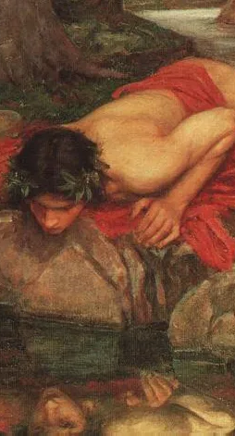
Piety is a Part of Justice
Ironically, Socrates’s point is less obvious with respect to the Greek gods, who were notoriously vain and resentful, and might well be expected to benefit from human adoration and compliance.
But it might be more difficult to see how the God of Abrahamic religions, for example, could benefit or be influenced by our actions.

Slide 43
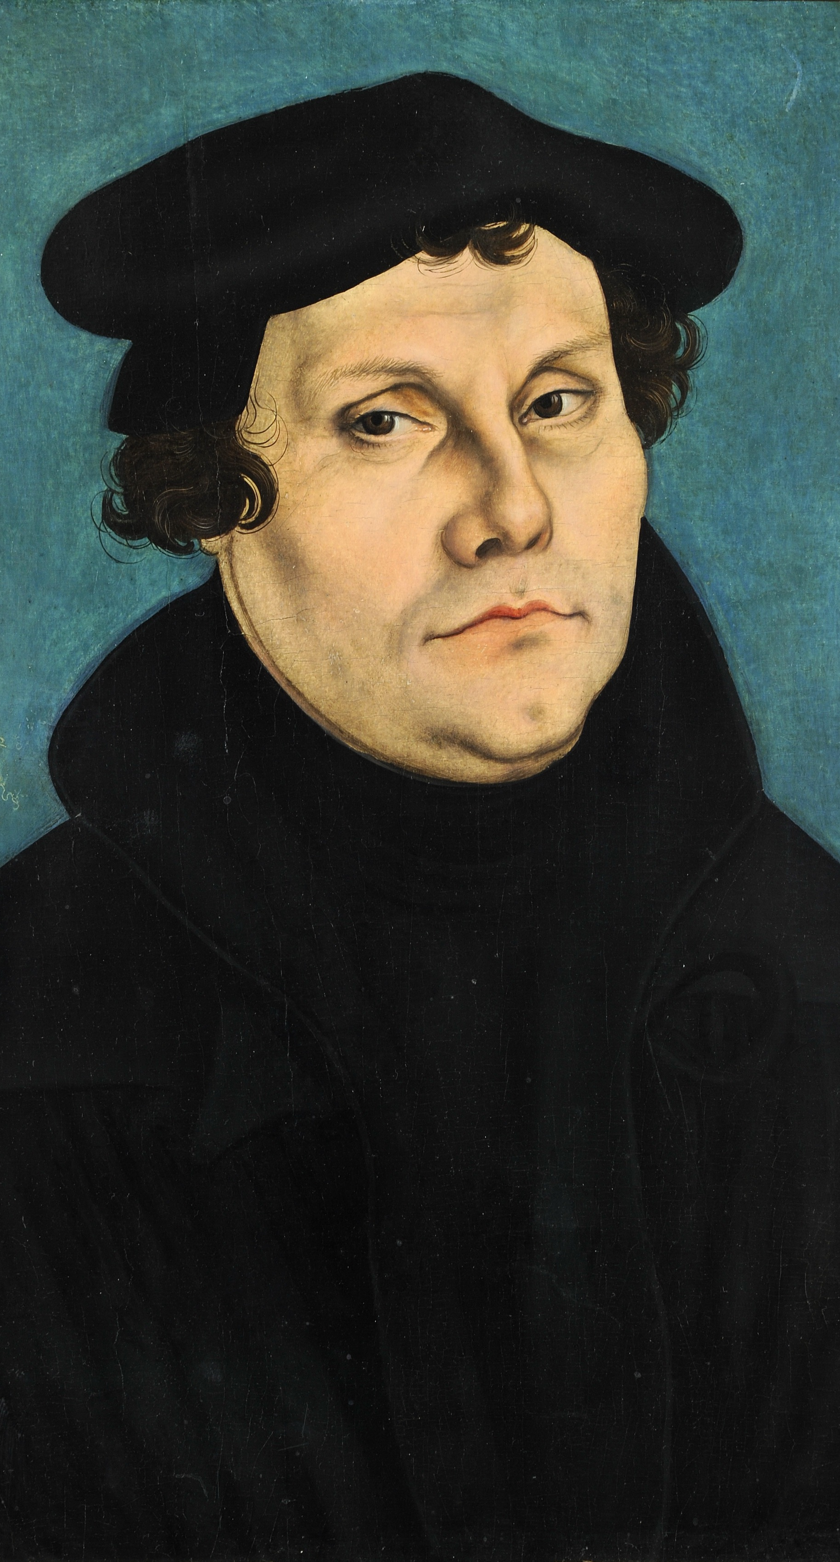
Piety is a Part of Justice
Incidentally, this will become a huge issue during the Reformation.
Thinkers like Luther and Calvin will be influence on this point by Augustine (up next).
And Augustine, as we’ll see, was massively influence by … Plato.

Slide 44
The Pious Is What Is Dear to the Gods

Slide 45
The Pious is What Is Dear to the Gods
Under pressure from Socrates, Euthyphro offers one last definition:
The pious is “of all things most dear” to the gods (15a)
What has gone wrong here?
We are right back where we started: The pious is what is dear to the gods.

Slide 46
The Pious is What Is Dear to the Gods
Socrates is a philosopher, so he says, okay, let’s start again from the beginning.
Euthyphro is not a philosopher so … he walks away.

Slide 47
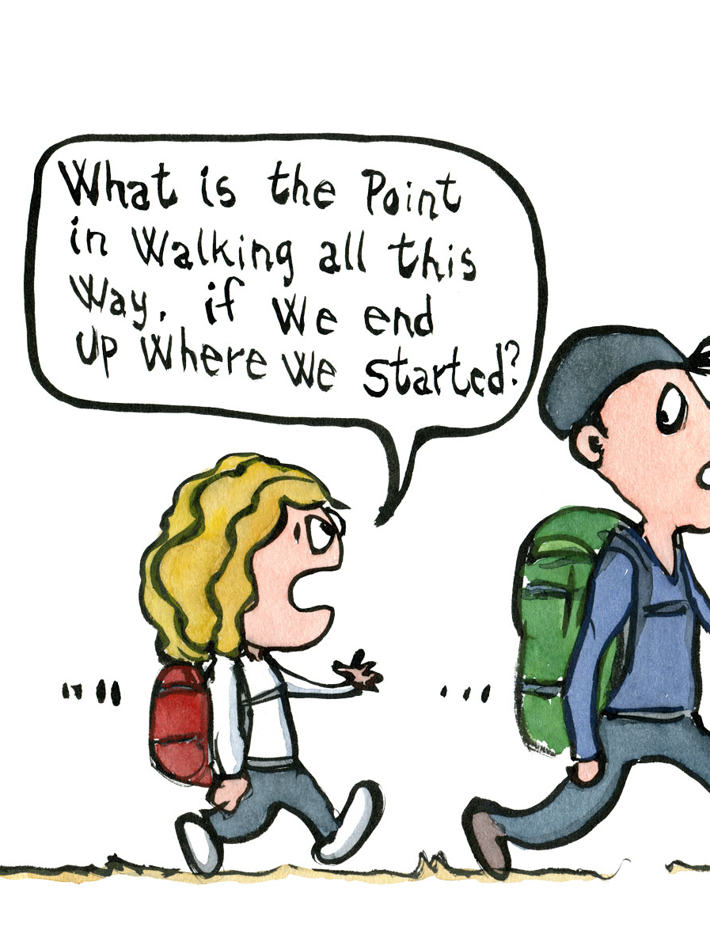
The Pious is What Is Dear to the Gods
A fair warning: Don’t be surprised if we end up at the end of the semester just like Socrates – namely, back where we started, hopefully a little wiser, but no more, and perhaps even less, certain than when we started.

Slide 48
A Few Course Details

Slide 49
A Few Course Details
A list of recommended book editions is offered on the syllabus.
Those editions will be on reserve at Robbins and Lamont.
The syllabus also includes links to online editions.
Lecture slides will posted.
A textbook is not required but is available.

Slide 50
A Few Course Details
We will have a mid-term and final exam.
Ten writing opportunities: choose four, two before midterm.
There are different kinds of writing opportunities: exegetical; argumentative.
Rubrics are available; a good idea to consult before writing.

Slide 51
A Few Course Details
Phil 31 students – office hours
  Finlay: Thursdays, 10:30-12:30 (Emerson 107)
  Jeff: Thursdays, 3:00-5:00 (Emerson 202)
E-101 students – discussion board
Topics should be easy to engage with and discuss

Slide 52
A Few Course Details
More details are available on the course web site and syllabus.
Please let me know if you have any questions.
Until next class!

Slide 53
Lecture 1: What is Piety? – The End

